Slide 1

Cloud computing
Strategys und Architectures

Slide 2
Presenter – Sia Ghassemi
sia consulting
Cloud-Consulting
Cloud-Development
Cloud-Security
Blockchain-Consulting
Domain Modelling
Trainings
Sia Ghassemi
Developer
Software Architect
Software Security Expert
Speaker
Microsoft Azure MVP

Slide 3
Agenda
What is Cloud Computing
What kind of Clouds are there
What are the Cloud Service-Models
How safe is Cloud Computing
Cloud architecture – Infrastructure architecture vs software architecture
Cloud Strategies – how to use Cloud Computing
Q&A

Slide 4
What is Cloud Computing?

Slide 5




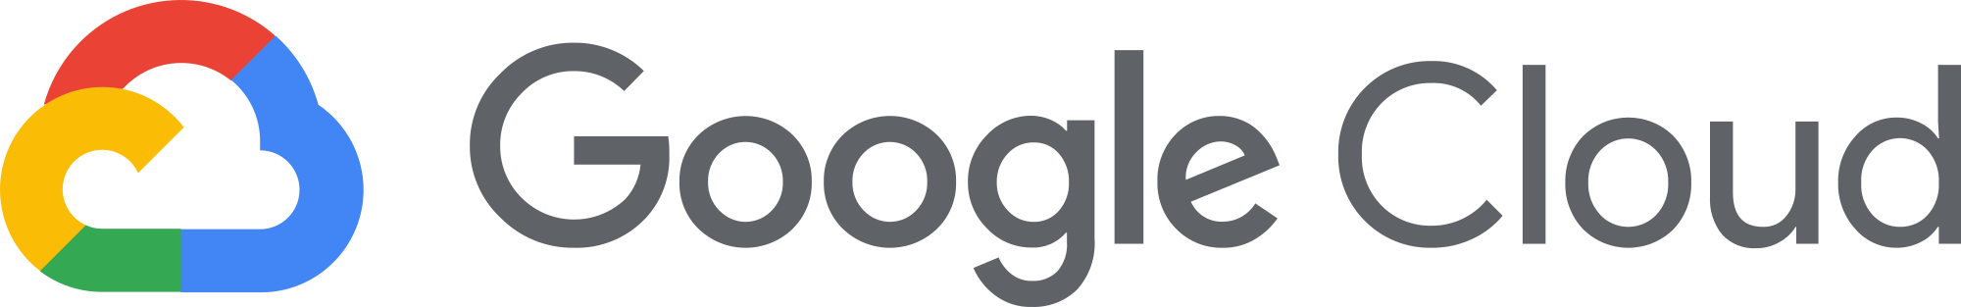




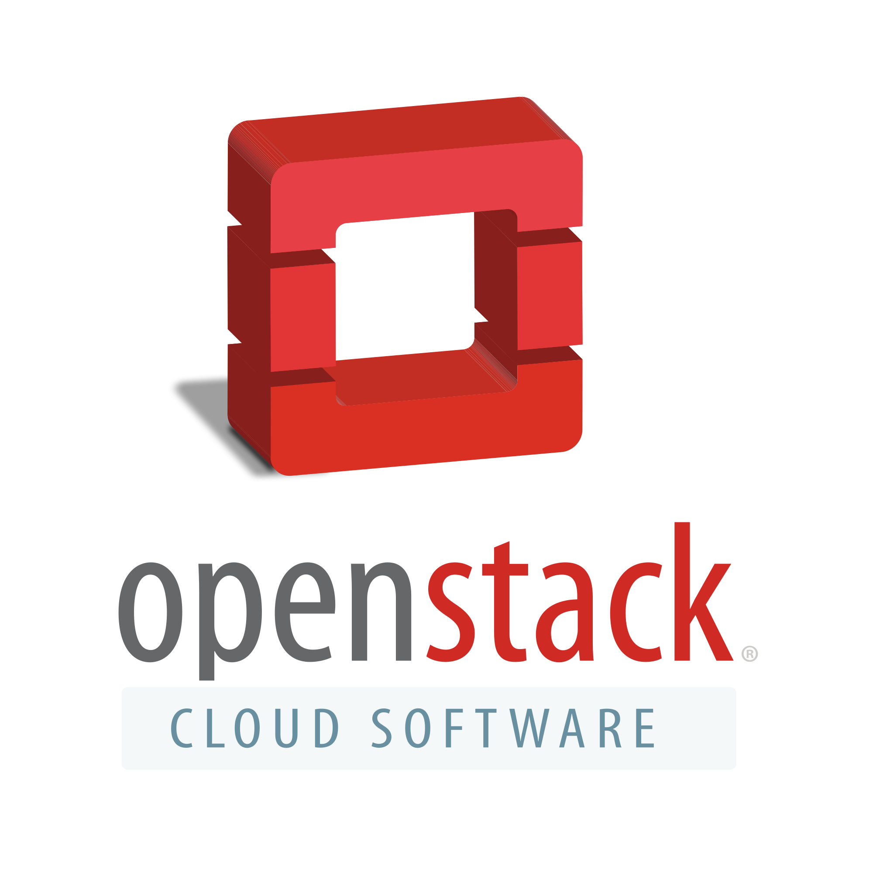



Cloud Computing

Slide 6
Differences to Datacenters Providers
Datacenter Provider
Cloud Provider
Outsourcing of resources
Rent a server
managed server
Known Providers
Strato
1&1
T-Systems
Resources are provided
High redundancy and reliability
Different Service-Models
Known Providers
Microsoft Azure
Amazon AWS
Google Cloud Plattform

Slide 7
Cloud Adoption Stats
The public cloud service market is expected to reach $623.3 billion in 2023 worldwide
83% of enterprise workloads will be in the cloud by 2020
94% of enterprises already use a cloud service
30% of all IT budgets are allocated to cloud computing
66% of enterprises already have a central cloud team or a cloud center of excellence
Organizations leverage almost 5 different cloud platforms on average
50% of enterprises spend more than $1.2 million on cloud services annually
In 2021, the public cloud infrastructure will grow by 35%!
https://hostingtribunal.com/blog/cloud-adoption-statistics/

Slide 8
Cloud Computing
Collection of several services
IaaS, PaaS, SaaS, FaaS, CaaS
Easy Model
Light learning curve
Different pricing models

Slide 9
What kind of Clouds are there?

Slide 10
Formen der Cloud
Private Cloud – On Premise Cloud
Goverment Cloud – for Governments
Public Cloud – most common
Hybrid Cloud – private Cloud + public Cloud + own DC
Mutli Cloud – mixed use of public Cloud Providers

Slide 11
What are the Cloud Service-Models?

Slide 12
Cloud Service Models
IaaS – Infrastructure as a Service
PaaS – Platform as a Service
SaaS – Software as a Service
FaaS – Functions as a Service
CaaS – Containers as a Service

Slide 13
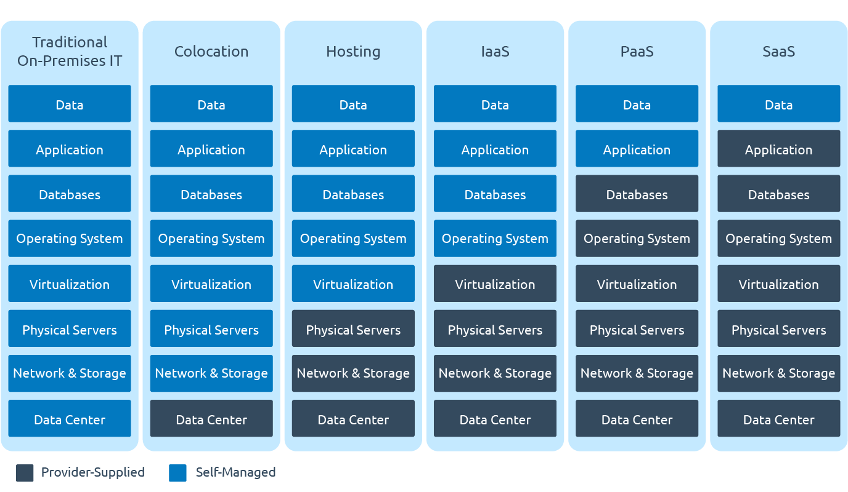
Cloud Service Models

Slide 14
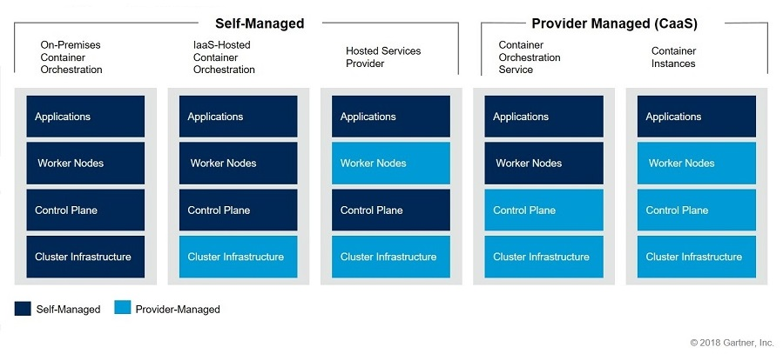
Containers as a Service

Slide 15
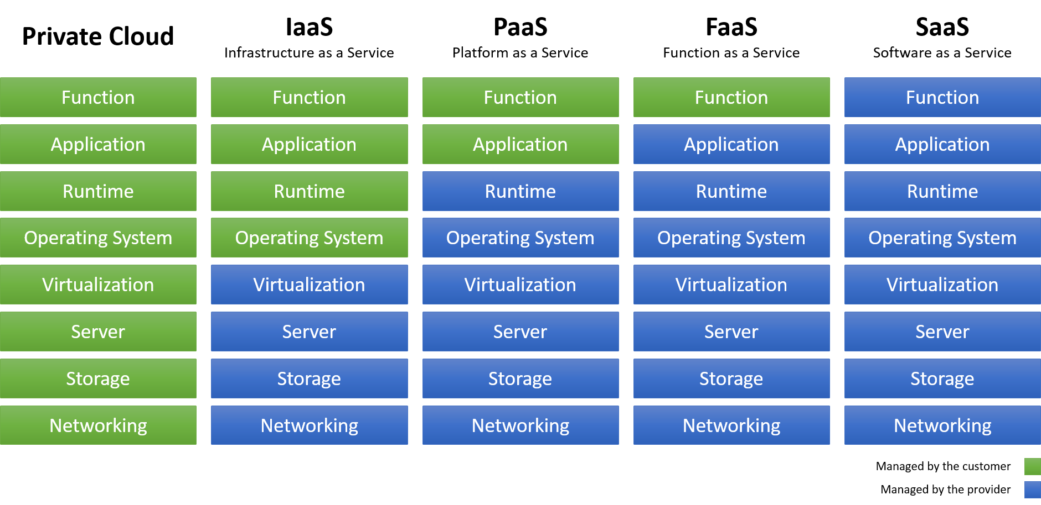
Functions as a Service

Slide 16
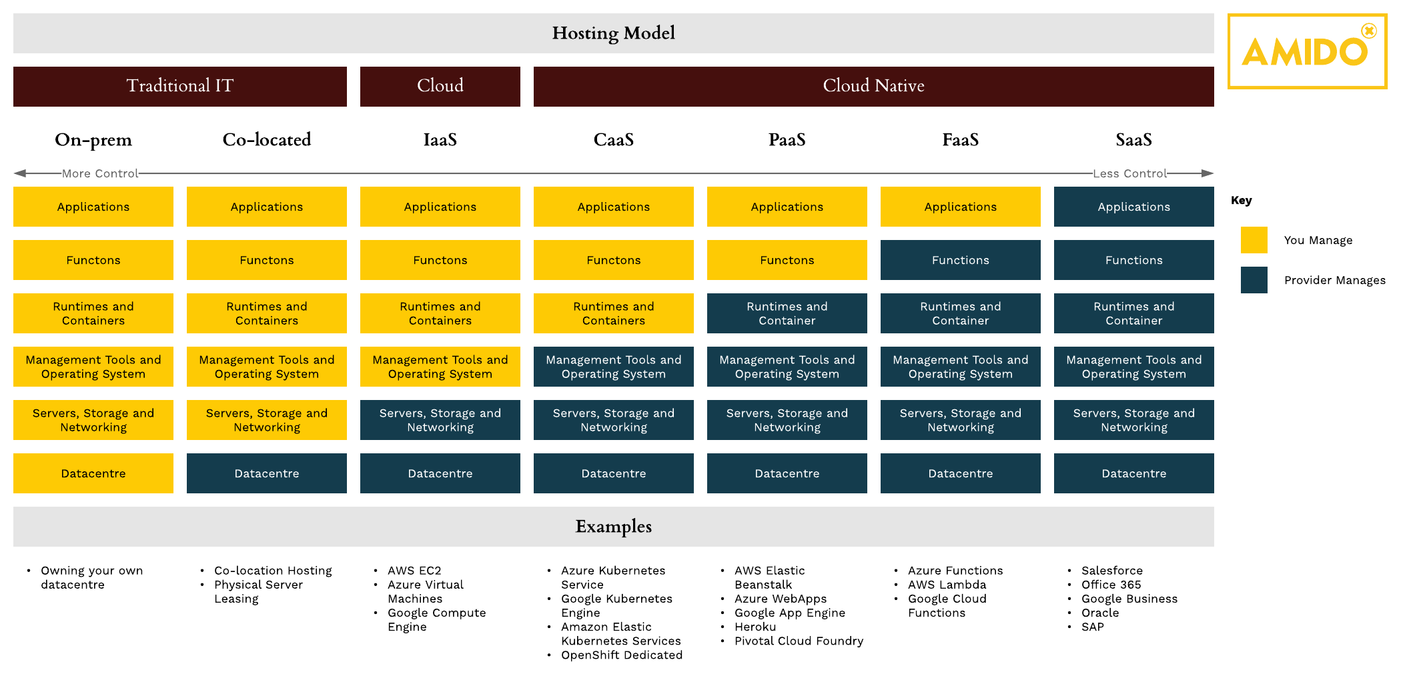
X as a Service

Slide 17
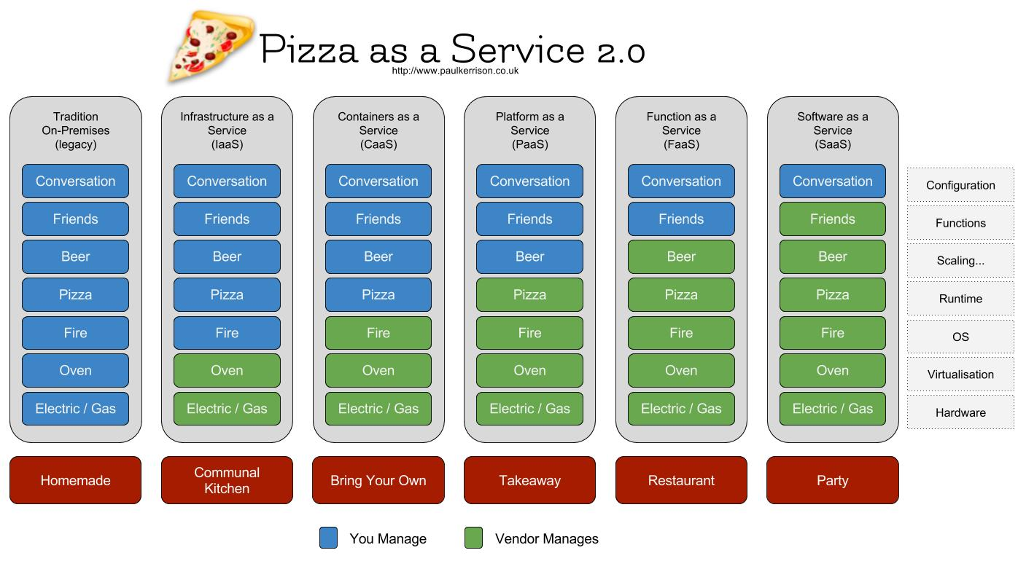
Pizza as a Service

Slide 18
How safe is Cloud Computing?

Slide 19
Infrastructure Safty Cloud Providers need to secure data of multiple customers
Security Center with recommedation
Web Application Firewall / DDoS protection
Identity Management
Hardware Security Modules
Daten encryption
ISO/DSGVO assessment center
Secure communication
Datencenter (physical) location unknown

Slide 20
Cloud architecture
Infrastructure architecture vs software architecture

Slide 21
Cloud architecture
Infrastructure
Software
Containers or Virtual Machines
Networkarchitecture
Redundancy
Resources available world wide
Monitoring
Bus-systems
Communicationchannels
Event-Driven Softwarearchitecture
Security first
Microservices – distributed Systems
Database-systems
Mix IaaS, CaaS, PaaS, FaaS, SaaS

Slide 22
Cloud Strategies
how to use Cloud Computing?

Slide 23
Myths of Cloud Computing
Myth
Truth
Everything is cheaper, when Cloud!
WE SHALL PREVENT Vendor lock-in or DIE!
Cloud Computing is not safe for customer data and not GDPR ready!
One Vendor to rule them all!
Lift and Shift is easy and fast, so we are cloud computing ready!
One can save costs, when cloud, but it depends
Vendor Lockin is ok, if you stick to some rules
It depends on you software and infrastructe architecture
Multi cloud has a bright future, use services that you need from different providers
Lift and Shift might be a fast solution, but clouds bring other things that you need to think of first and lift and shift is always more expansive in clouds

Slide 24
Native Cloud Computing is the future
Customer use more PaaS, CaaS, SaaS and FaaS
Cheaper thanks to consumption plans
Virtual Networks and Security Groups for security
VPN / Express Routes for Hybrid Networking
Use Service with the best in class Provider (SAP)
Self organized DevOps-Teams
Domain Modelling with Security-First, Cloud-First approach
Softwarearchitecture needs rethinking (event-driven, distributed)
Remove dependencies and container when possible

Slide 25
Azure Overview
Plattform and Services

Slide 26
Categories
AI + Machine Learning
Analytics
Blockchain
Compute
Containers
Databases
Developer Tools
DevOps
Hybrid + Multicloud
Identity
Integration
Internet of Things
Management and Governance
Media
Migration
Mixed Reality
Mobile
Networking
Security
Storage
Web
Windows Virtual Desktop

Slide 27























Compute

Slide 28
Compute Service
IaaS
PaaS
Virtual Machines (Scale Sets)
VM Image Builder
Quantum
Kubernetes Service
VMware Solutions
App Services
Container Instances
Batch
Spring Cloud
Static Web Apps

Slide 29
Virtual Machines (Scale Sets) Series
A
Beginner-Level, Test Server or Server with less load
Bs
Price optimized Level, small databases, build servers
D
Common Level, midsize databases, business applikationen
DC
Common Level + Privacy-Optimized, Handling of GDPR relevant PII

Slide 30
Virtual Machines (Scale Sets) Series
E
Memory optimized Level, SAP Hana, applications that need lots of memory
F
CPU-optimized, Batch processing, Analytics, Web Servers
G
Memory and Storage optimized, big databases, ERP systeme, SAP
H
HPC, Big Data, Analytics, Qubes, Simulationen, Machine Learning

Slide 31
Virtual Machines (Scale Sets) Series
Ls
Storage optimized, NoSQL Databases
M
high memory and high CPU needs, SAP Hana, SQL Hekaton
Mv2
I can‘t get enough memory and CPUs, up to 416 vCPUs and 12 TB RAM
N
GPU Compute, NVIDIA Tesla and M60 GPUs, Simulations, Machine Learning, Gaming, Video Encoding

Slide 32
Kubernetes Service
Managed Kubernetes Cluster
Orchestrator for Microservices
Integration to other Azure Service
Private Network
Easy scalability
Virtual Kubelets

Slide 33
Azure App Service
PaaService for Web/Mobile application
Out of the Box support for Functions as a Service
Support for Docker Images
Easy Auth
Windows and Linux OS support
Support for
Microsoft .NET, Java, Python, Node.JS

Slide 34





















Databases

Slide 35
Database Service
IaaS
PaaS
SQL Server on Virtual Machine
SQL Server Managed Instance
Managed Instance for Apache Cassandra
SAP Hana
SQL Database
Cache for Redis
MariaDB
PostgresDB
MySQL
Cosmos DB

Slide 36
SQL Server Managed Instance
fully gemanaged by Microsoft
Real MS SQL Server
Insolated
Encryption at REST
Easy Scaling

Slide 37
SQL Database
MS SQL Database
simulated MS SQL Server
Encryption at REST
Easy Scaling

Slide 38
Azure Cosmos DB
NoSQL Server
very flexibel
Dialects: SQL, MongoDB, Cassandra, Gremlin, PostgresDB
ConsistancyModels: Multi-Write Consistency to Eventual Consistancy
World wide Cluster
Reponse in singel digit ms possible
Integration into other Azure Services

Slide 39









DevOps

Slide 40
DevOps Services
IaaS
PaaS
Azure DevOps for Servers
Self-Hosted Agents
Artifacts
Boards
Pipelines
Repos
Monitor
Test Plans / DevTest Labs

Slide 41
Azure DevOps
Managed instance by Azure but can be used for all kinds of DevOps tasks also for On-Premise and other Cloud/Datacenter Providers
Boards: Ticket Tracking, Issue Management (like Jira)
Repos: Git Repositories as Source Version Control
Artifacts: Artifact storage with multi feed support (NuGET, Maven, npm, Docker, etc)
Pipelines: Build and Release Pipelines with qualitygate support

Slide 42











Identity

Slide 43
Identity
Azure Active Directory
AAD Domain Services
AAD External Identities
Information Protection

Slide 44
Types of Azure Identities
App Registration / Service Principal → Username & Password/RedirectUri
Managed Identity → Username only
Workload Identity → Username only
Role Based Access Control (RBAC)
Azure Built-in Roles
Custom Roles
Define Roles for Azure Identities, AAD Users or AAD Groups

Slide 45
Azure Active Directory
Active Directory
User Management
Resourc (devices, rooms etc.) Management
Application (Registration) Management
OAuth Server and Management
B2C-Version
Custom Branding
Selfservice
MFA

Slide 46






















Management and Governance

Slide 47
Management and Governance
Governance
Management
Azure Policy
Azure Lighthouse
Azure Advisor
Azure Management Groups
Azure Purview
Azure Blueprints
Azure Backup
Azure Resource Manager
Azure Site Recovery
Azure Automanage
Azure Arc

Slide 48
Azure Blueprints
Templates for provisioning of Azure Resources on management group level
Locking of Resource Groups
Automation
Versioning
Distribution of Userrights and Access Control

Slide 49
Azure Arc
Server overview (Linux and Windows) and Service, Databases
In Azure
On Premise
Other Cloud Providers
Datacenter Providers
OS Versions
Available Updates
Log Analysis

Slide 50
Azure Advisor
Recommedations for Azure Resources
Overview for Cost reduction possiblities
Notifications

Slide 51
































Networking

Slide 52
Networking
IaaS
PaaS
Express Route
VPN
VNET & Network Security Groups
Network Watcher
Load Balancer
Firewall
DNS
Traffic Manager
Azure Bastion
Application Gateway
Front Door
Private Link
Virtual WAN
Private Link
Private Endpoint

Slide 53
Azure Application Gateways
Loadbalancing
SSL-Offloading
Health-Monitor
Web Application Firewall
Intelligent Routing

Slide 54
Azure Front Door
Global Loadbalancing
CDN
Web Application Firewall
DDoS Protection
Analytics
Intelligent Routing

Slide 55
Azure Private Link & Private Endpoint
Link to Azure Resources without Public IP
Endpoint to Azure Services without Public IP
Access with VPN

Slide 56

Azure Bastion
RDP and SSH access on Server without Public IP
Connection out of the Portal
No VPN needed

Slide 57







Security

Slide 58
Security
System
Data
Azure Sentinel
Security Center
Azure Defender
Azure Defender for IoT
Azure Defender for All
Azure KeyVault
Dedicated HSM
AAD
WAF

Slide 59
Azure Security Center
Security overview for Servers and Services
In Azure
On Premise
At AWS/GCP
Security recommendation
Security score
Compliance score
Azure Defender overview

Slide 60
Azure Key Vaults
HSM (Software and Hardware)
Rolling versioning
Start and end date
Secrets
Store and retrieve
Keys
Store, retrieve and generate symmetric and asymmetric keys
Encrypt and decrypt Data
Sign and verify Data
Certificates
Store and retrieve

Slide 61














Storage

Slide 62
Storage
Archive Storage
NetApp Files
Azure Storage Files
Azure Storage Blobs
Azure Storage Queues
Azure Storage Tables
Azure Disks
Azure Data Lake
Azure Data Box

Slide 63
Azure Storage Accounts
Storage for
Blobs
Queues
Tables
Files
Support for Leases (Locks)
Support for FileShares (mount SMB)

Slide 64
Azure Data Lake
Store structured and unstructured data
Connect Azure Stream Analytics
Connect Azure Data Facotry
Connect Power Palttform
PowerBI
Power Apps
Power Automate

Slide 65
Demos
Azure Identity and RBAC
Azure DevOps

Slide 66
End
That’s it

Slide 67

Q&A

Slide 68
Resoruces
https://www.ispsystem.ru/sites/all/themes/ispsystem//images/news/2018/10/xaas/xaas-eng.png
https://blogs.gartner.com/tony-iams/files/2018/12/caas-hires3.jpg
https://i.stack.imgur.com/ehcV1.png
https://miro.medium.com/max/3760/1*hVFqlbCesXwT3hfcy9t7Ig.png
Pizza as a Service 2.0 – Paul Kerrison
Cloud Adoption Statistics - It's Everywhere & Everyone's Using It in 2021! (hostingtribunal.com)
Directory of Azure Cloud Services | Microsoft Azure

